Slide 1
Table Joins

Slide 2
Joins
allows you to join multiple tables into a single table (for example table1.column1, table1.column2, table2.column3, table2.column4 can be joined into a result set containing all 4 columns)

Slide 3
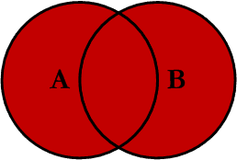
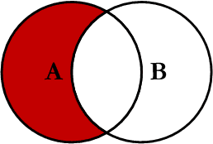
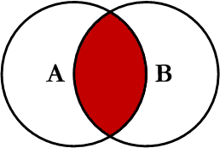
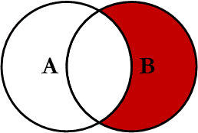
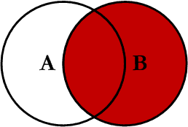
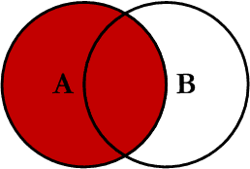
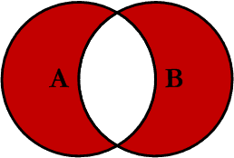
Join

Slide 4
Basic Join
SELECT *
FROM Students, CourseAttendance
WHERE Students.StudentID = CourseAttendance.StudentID;

Slide 5
Common Joins – Inner vs Outer
inner join (default)
if join predicate is satisfied, the row is added
outer join
does not require both tables to have matching records
all records from one table are pulled, matching records from the other table are joined
left or right outer joins
SELECT * FROM tableA LEFT OUTER JOIN TableB ON TableA.Column1 = TableB.Column1;
will pull all records from tableA, matching from tableB

Slide 6
Common Joins cont’d
outer join cont’d
SELECT *
FROM TableA RIGHT OUTER JOIN TableB
ON TableA.Column1 = TableB.Column2;
will pull all records from tableB, matching from tableA
full outer join
pulls records from both tables, matches as many as it can

Slide 7
Less Common Joins
Natural Join – compares same column names between the two tables
Cross Join – does not filter data; joins the data as best as it can – results in a Cartesian product
“has very few practical uses”
Notes:
will not use this in this class, just an FYI

Slide 8
Join Examples

Slide 9
Inner Join (order, parts)
partSN | partDesc | cost
001 | Part 1 | $20
002 | Part 2 | $40
003 | Part 3 | $60
004 | Part 4 | $80
orderNum | partSN | quantity
1001 | 002 | 2
1002 | 003 | 1
1003 | 004 | 1
1004 | 005 | 2
orderNum | partSN | quantity | partDesc | cost
1001 | 002 | 2 | Part 2 | $40
1002 | 003 | 1 | Part 3 | $60
1003 | 004 | 1 | Part 4 | $80

Slide 10
Left Outer Join (order, parts)
partSN | partDesc | cost
001 | Part 1 | $20
002 | Part 2 | $40
003 | Part 3 | $60
004 | Part 4 | $80
orderNum | partSN | quantity
1001 | 002 | 2
1002 | 003 | 1
1003 | 004 | 1
1004 | 005 | 2
orderNum | partSN | quantity | partDesc | cost
1001 | 002 | 2 | Part 2 | $40
1002 | 003 | 1 | Part 3 | $60
1003 | 004 | 1 | Part 4 | $80
1004 | 005 | 2 | NULL | NULL

Slide 11
Right Outer Join (order, parts)
partSN | partDesc | cost
001 | Part 1 | $20
002 | Part 2 | $40
003 | Part 3 | $60
004 | Part 4 | $80
orderNum | partSN | quantity
1001 | 002 | 2
1002 | 003 | 1
1003 | 004 | 1
1004 | 005 | 2
orderNum | partSN | quantity | partDesc | cost
NULL | 001 | NULL | Part 1 | $20
1001 | 002 | 2 | Part 2 | $40
1002 | 003 | 1 | Part 3 | $60
1003 | 004 | 1 | Part 4 | $80

Slide 12
Full Outer Join (order, parts)
partSN | partDesc | cost
001 | Part 1 | $20
002 | Part 2 | $40
003 | Part 3 | $60
004 | Part 4 | $80
orderNum | partSN | quantity
1001 | 002 | 2
1002 | 003 | 1
1003 | 004 | 1
1004 | 005 | 2
orderNum | partSN | quantity | partDesc | cost
NULL | 001 | NULL | Part 1 | $20
1001 | 002 | 2 | Part 2 | $40
1002 | 003 | 1 | Part 3 | $60
1003 | 004 | 1 | Part 4 | $80
1005 | 005 | 2 | NULL | NULL

Slide 13
Which Join to use?
JOIN From Tables A and B
 | Matching A | All A
Matching B | INNER | LEFT OUTER
All B | RIGHT OUTER | FULL OUTER

